Slide 1
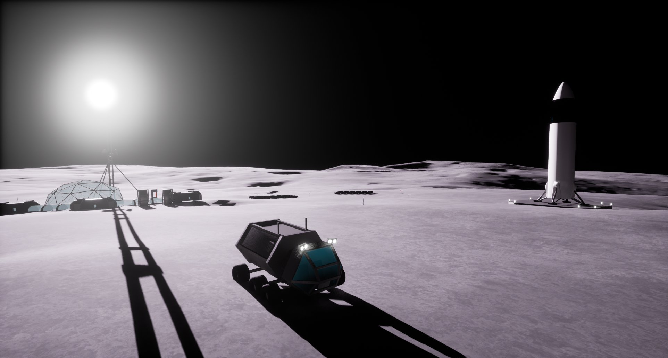
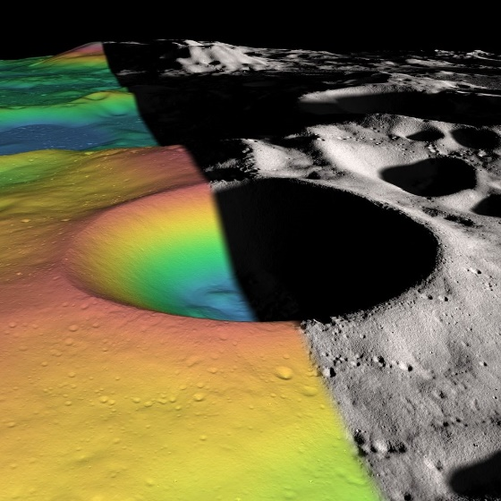



NASA App Development
Challenge 2022-2023
Pranav Sitaraman, Yuvraj Lakhotia, Benjamin Louie, Sushant Chadha, Akshada Guruvayur

Slide 2
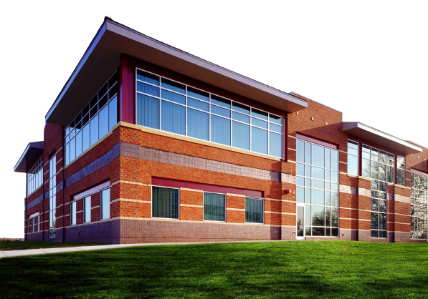
Who We Are
We’re from the Edison Academy Magnet School
STEM-focused rigorous public magnet school
Two majors:
Civil/Mechanical Engineering
Electrical/Computer Engineering
Team composed of students from both engineering “tracks”
Pranav Sitaraman, Yuvraj Lakhotia, Benjamin Louie, Sushant Chadha, Akshada Guruvayur

Slide 3
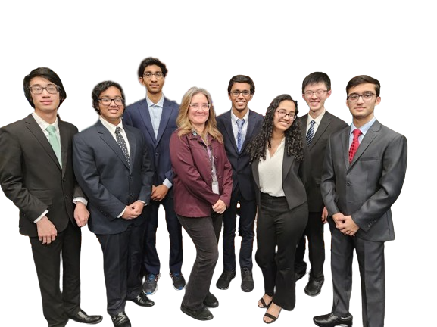
Our Team
Yuvraj Lakhotia (junior in EECS)
Pranav Sitaraman (junior in EECS)
Benjamin Louie (junior in CMET)
Sushant Chadha (junior in CMET)
Akshada Guruvayur (sophomore in CMET)
Our team wouldn’t have been possible without:
Michelle Gomes (CS Club advisor)
Samuel Lihn (mentor in EECS)
Aarav Agarwal (mentor in EECS)
Pranav Sitaraman, Yuvraj Lakhotia, Benjamin Louie, Sushant Chadha, Akshada Guruvayur

Slide 4
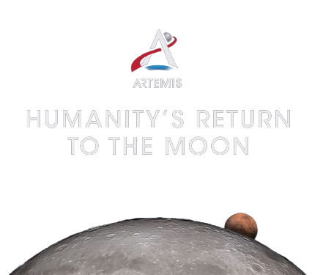
Our Approach
Holistic approach focused on the necessity of the simulation
Purpose of the app is to enable NASA to simulate a mission to the lunar south pole as part of the Artemis missions – this demands our app to be
Accessible: as easy to use for as many people as possible
Accurate: as close of a simulation to a true lunar mission as possible, and informative
Aesthetic: fun to use and explore with!
Pranav Sitaraman, Yuvraj Lakhotia, Benjamin Louie, Sushant Chadha, Akshada Guruvayur

Slide 5







Tools and Software
Discord
Communication within team & communities
Github & Google Drive
Project Storage, Collaboration
GIMP
Image Processing & Conversion
Unreal Engine 5 & Visual Studio
App Development
Blender
3D Modeling
Pranav Sitaraman, Yuvraj Lakhotia, Benjamin Louie, Sushant Chadha, Akshada Guruvayur

Slide 6
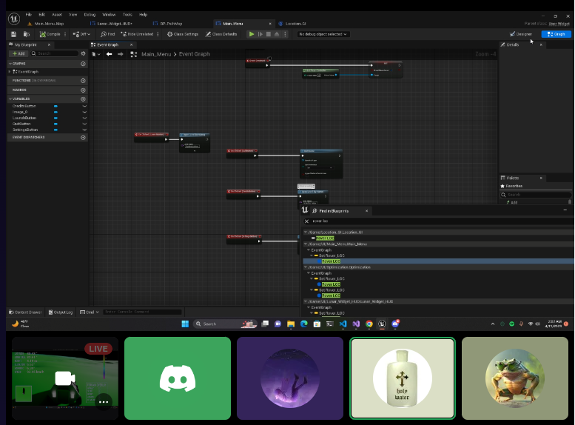
Division of Tasks
Research - Sushant Terrain - Yuvraj
Wayfinding - Pranav Modeling - Ben
Outreach - Akshada
Bonus Challenges!
Mini map
Relaxing slope constraint to 20 degrees
Pranav Sitaraman, Yuvraj Lakhotia, Benjamin Louie, Sushant Chadha, Akshada Guruvayur

Slide 7
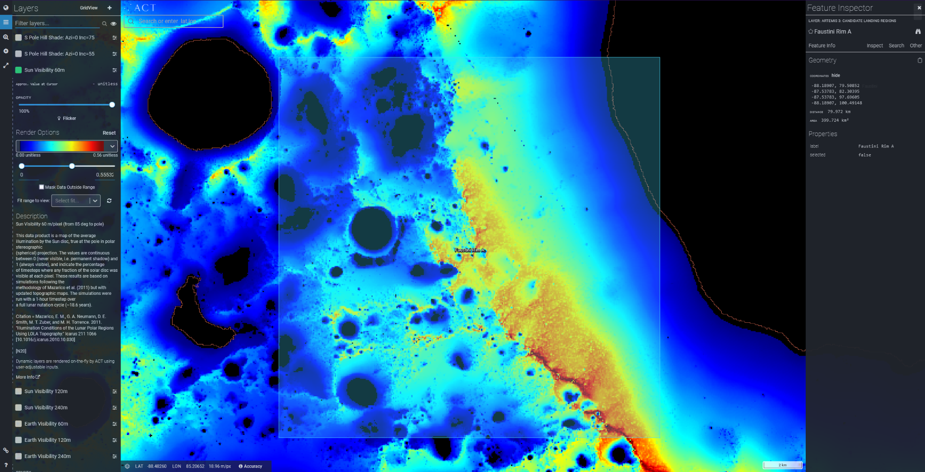
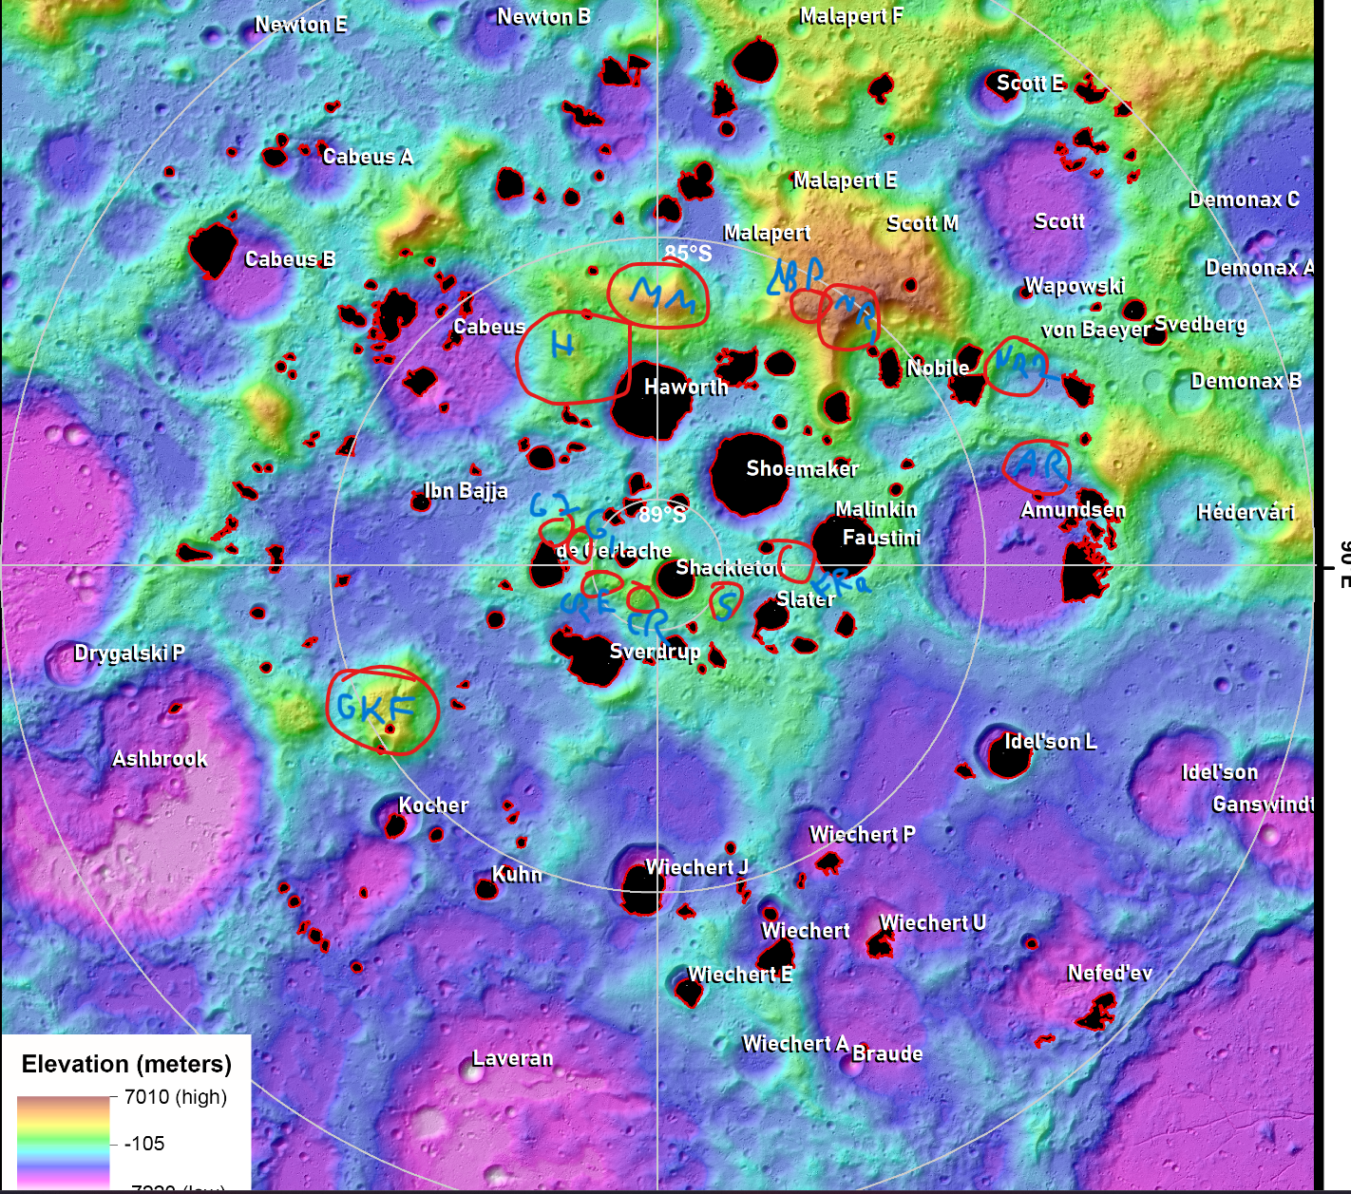
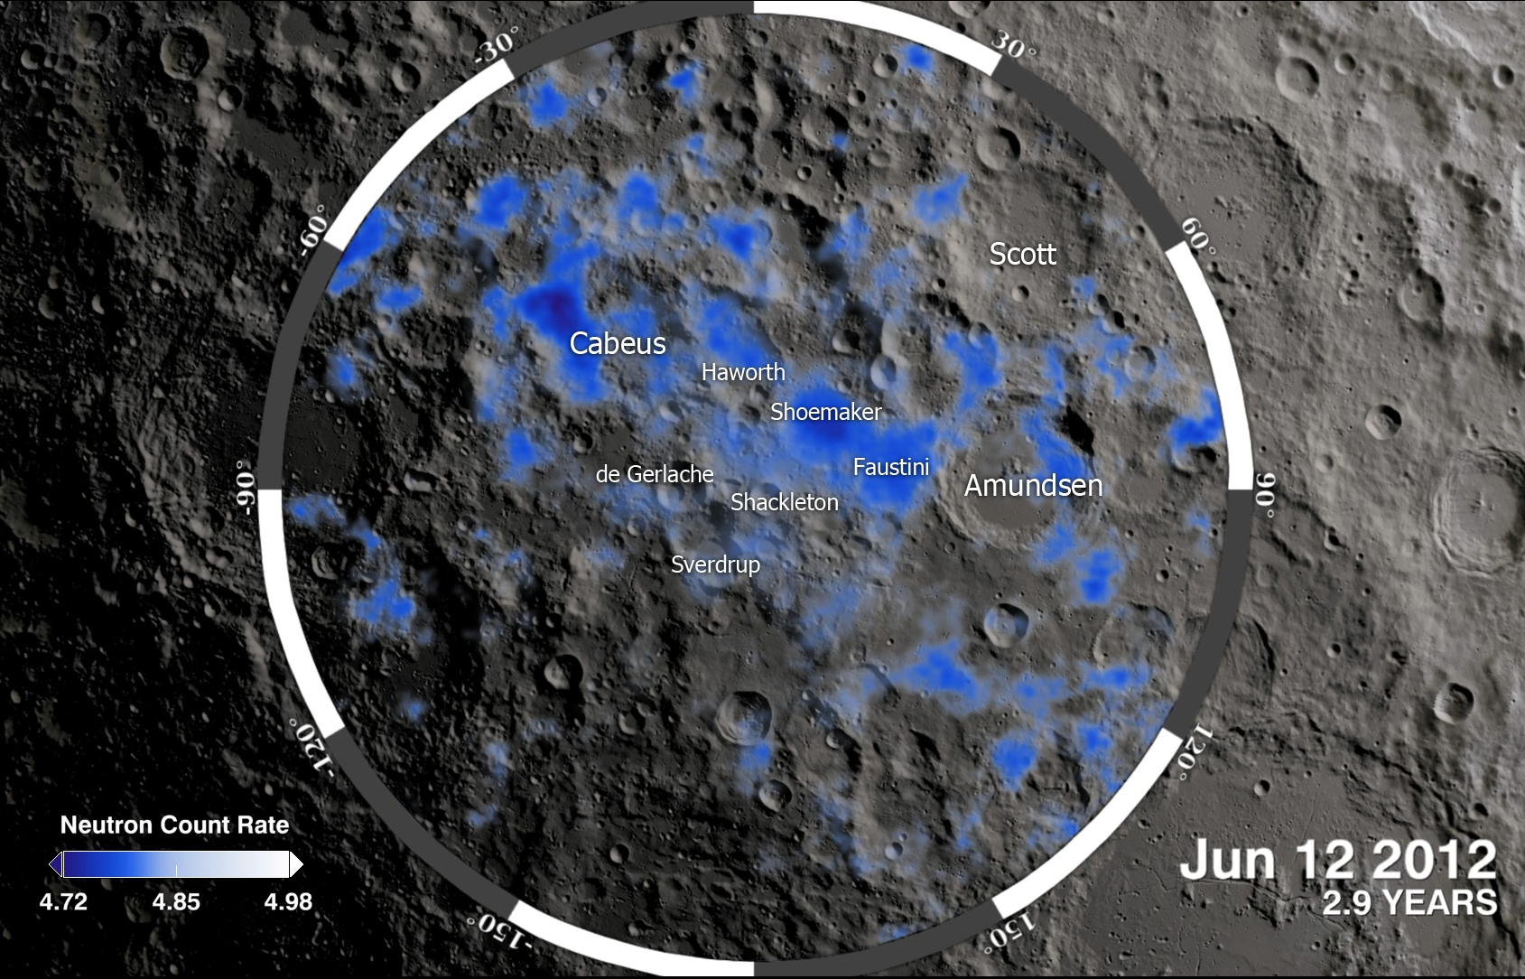
Research
Using the announced Artemis III candidate landing sites, we focused on analyzing maps and models. Our final selection was based off multiple data sources and balanced mission objectives & feasibility.
Sun visibility in Faustini Rim A
Our selected landing site
Elevation in Lunar South Pole
Visualize changes in terrain
Neutron count in Lunar South Pole
Lower count = more subsurface water
Pranav Sitaraman, Yuvraj Lakhotia, Benjamin Louie, Sushant Chadha, Akshada Guruvayur

Slide 8
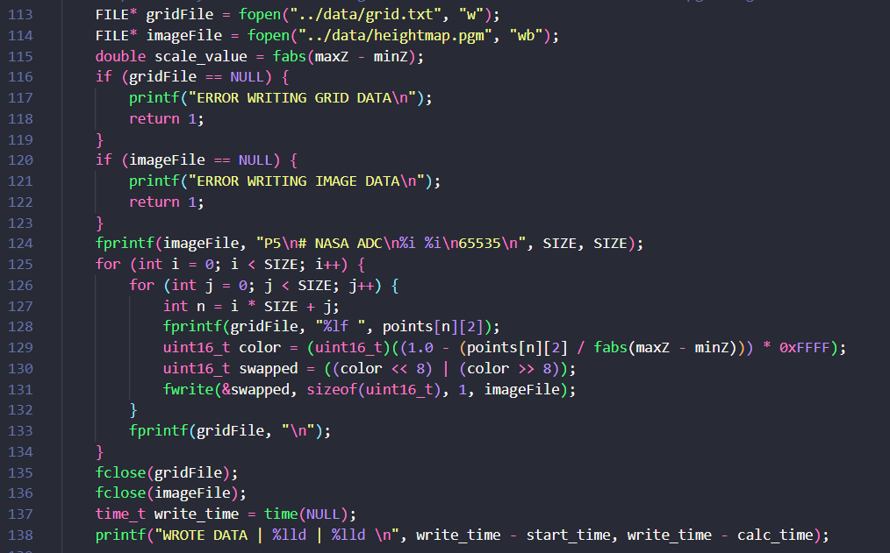
Terrain
NASA provided large lunar terrain dataset
Tried to stay within UE5’s terrain generation limits
Optimal resource utilization
Point cloud <x, y, z> → static mesh was too intensive
Developed custom method
C program to read, convert, write image
ImageMagick for .PGM to .PNG
Import 16-bit grayscale image into UE5
Pranav Sitaraman, Yuvraj Lakhotia, Benjamin Louie, Sushant Chadha, Akshada Guruvayur

Slide 9
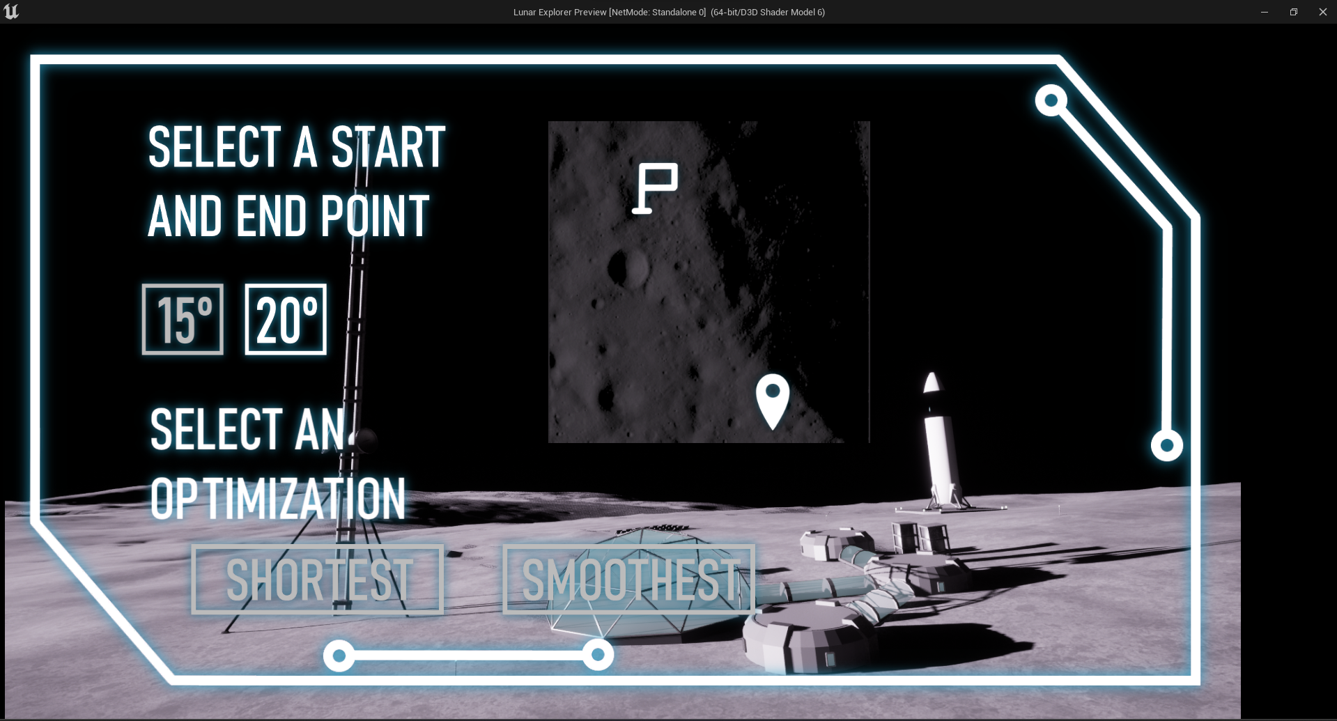

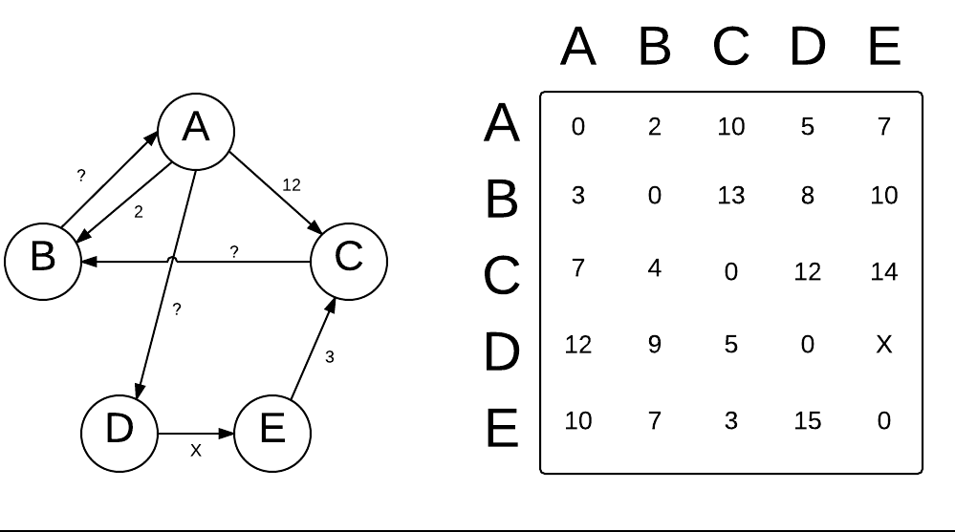
Wayfinding
Optimized
Customized
Floyd-Warshall
Shortest/smoothest path
User can select start/end point anywhere on site
Precomputed grid used to optimize real-time path calculations
Pranav Sitaraman, Yuvraj Lakhotia, Benjamin Louie, Sushant Chadha, Akshada Guruvayur

Slide 10
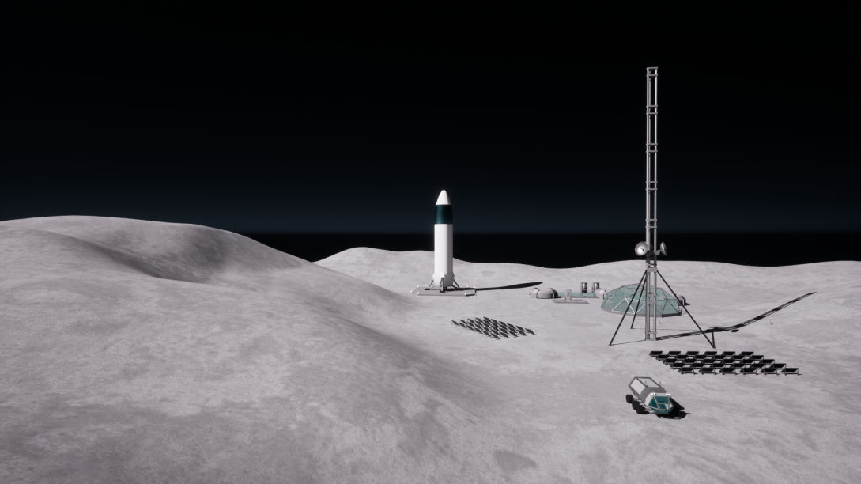
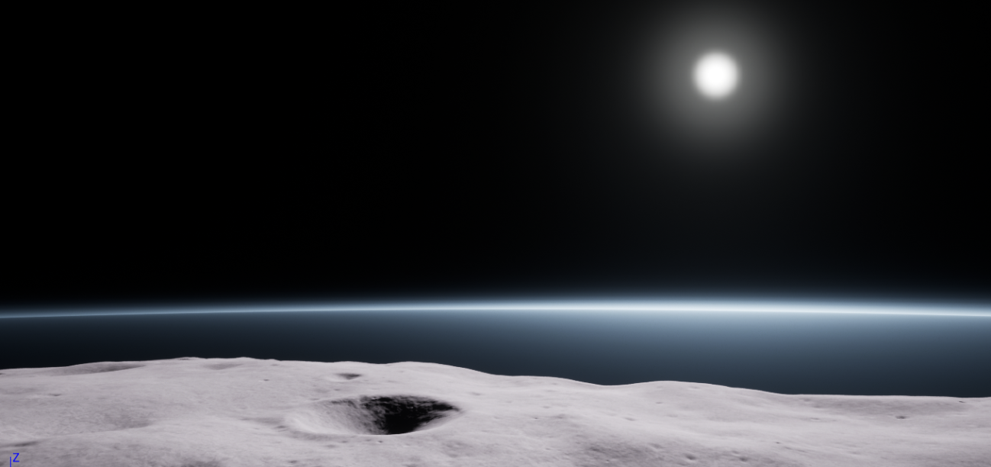
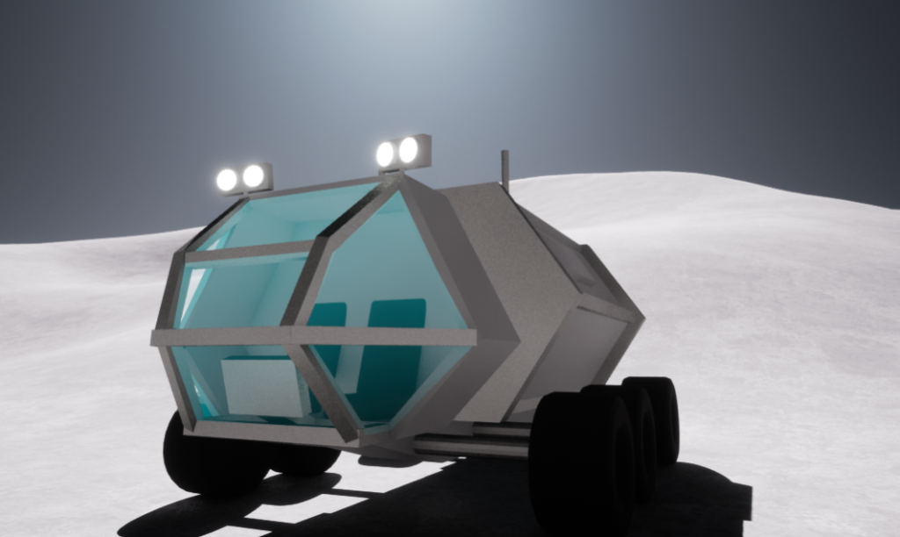
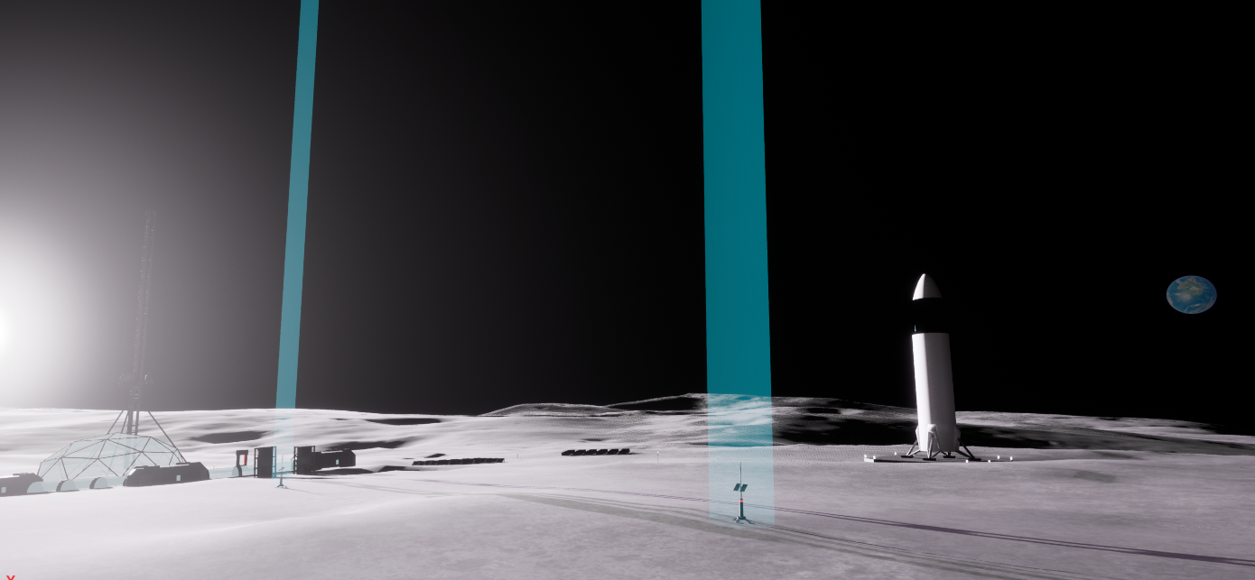
Modeling
Rover
Checkpoints
Inspired by JAXA and Toyota’s ‘Lunar Cruiser’ and the rover from The Martian
Located along pathfinding algorithm path
Lunar Base
Texture
Includes features necessary for survival on the Moon
Realistic & rough; blends details with interpolation
Pranav Sitaraman, Yuvraj Lakhotia, Benjamin Louie, Sushant Chadha, Akshada Guruvayur

Slide 11
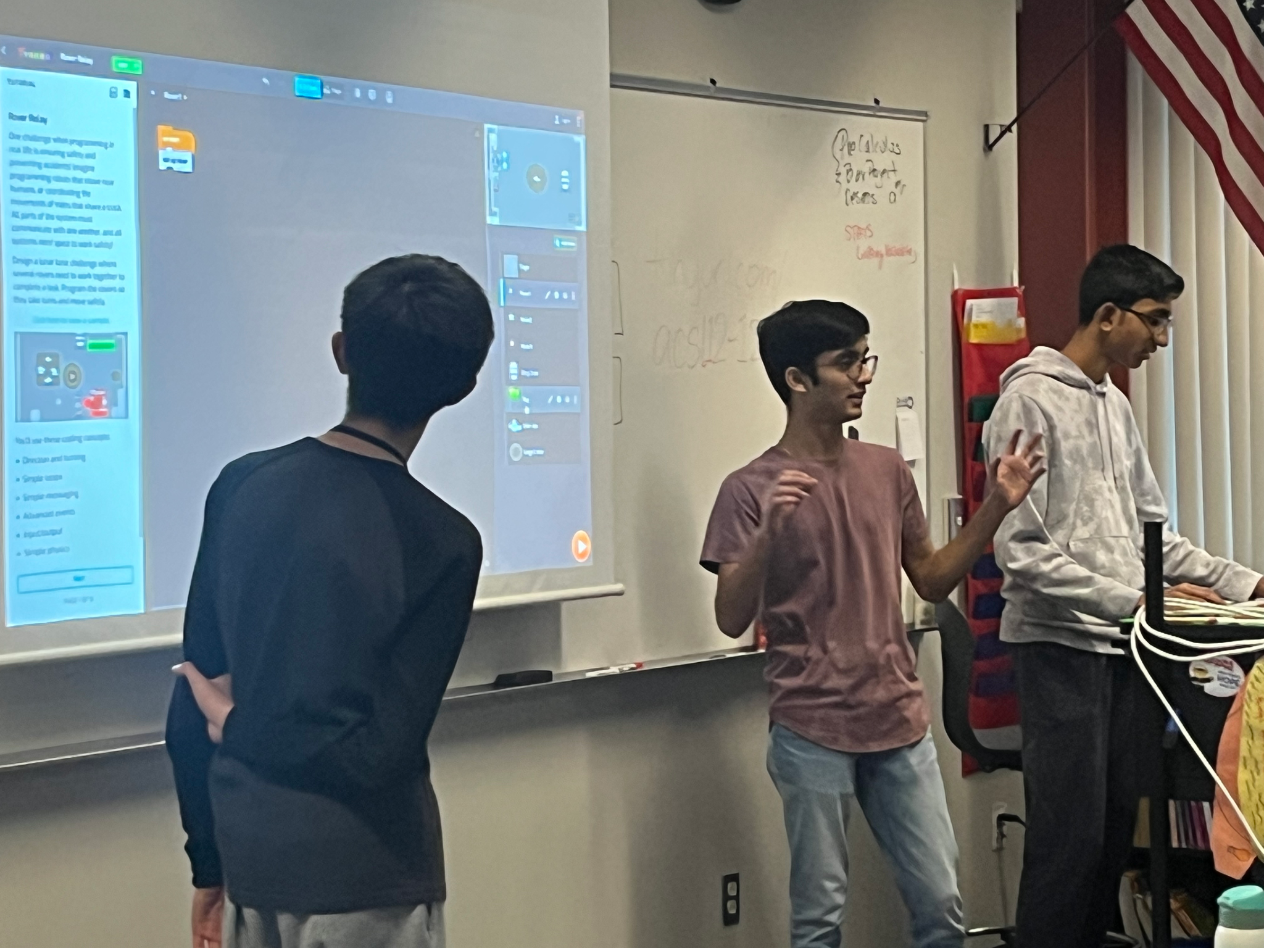
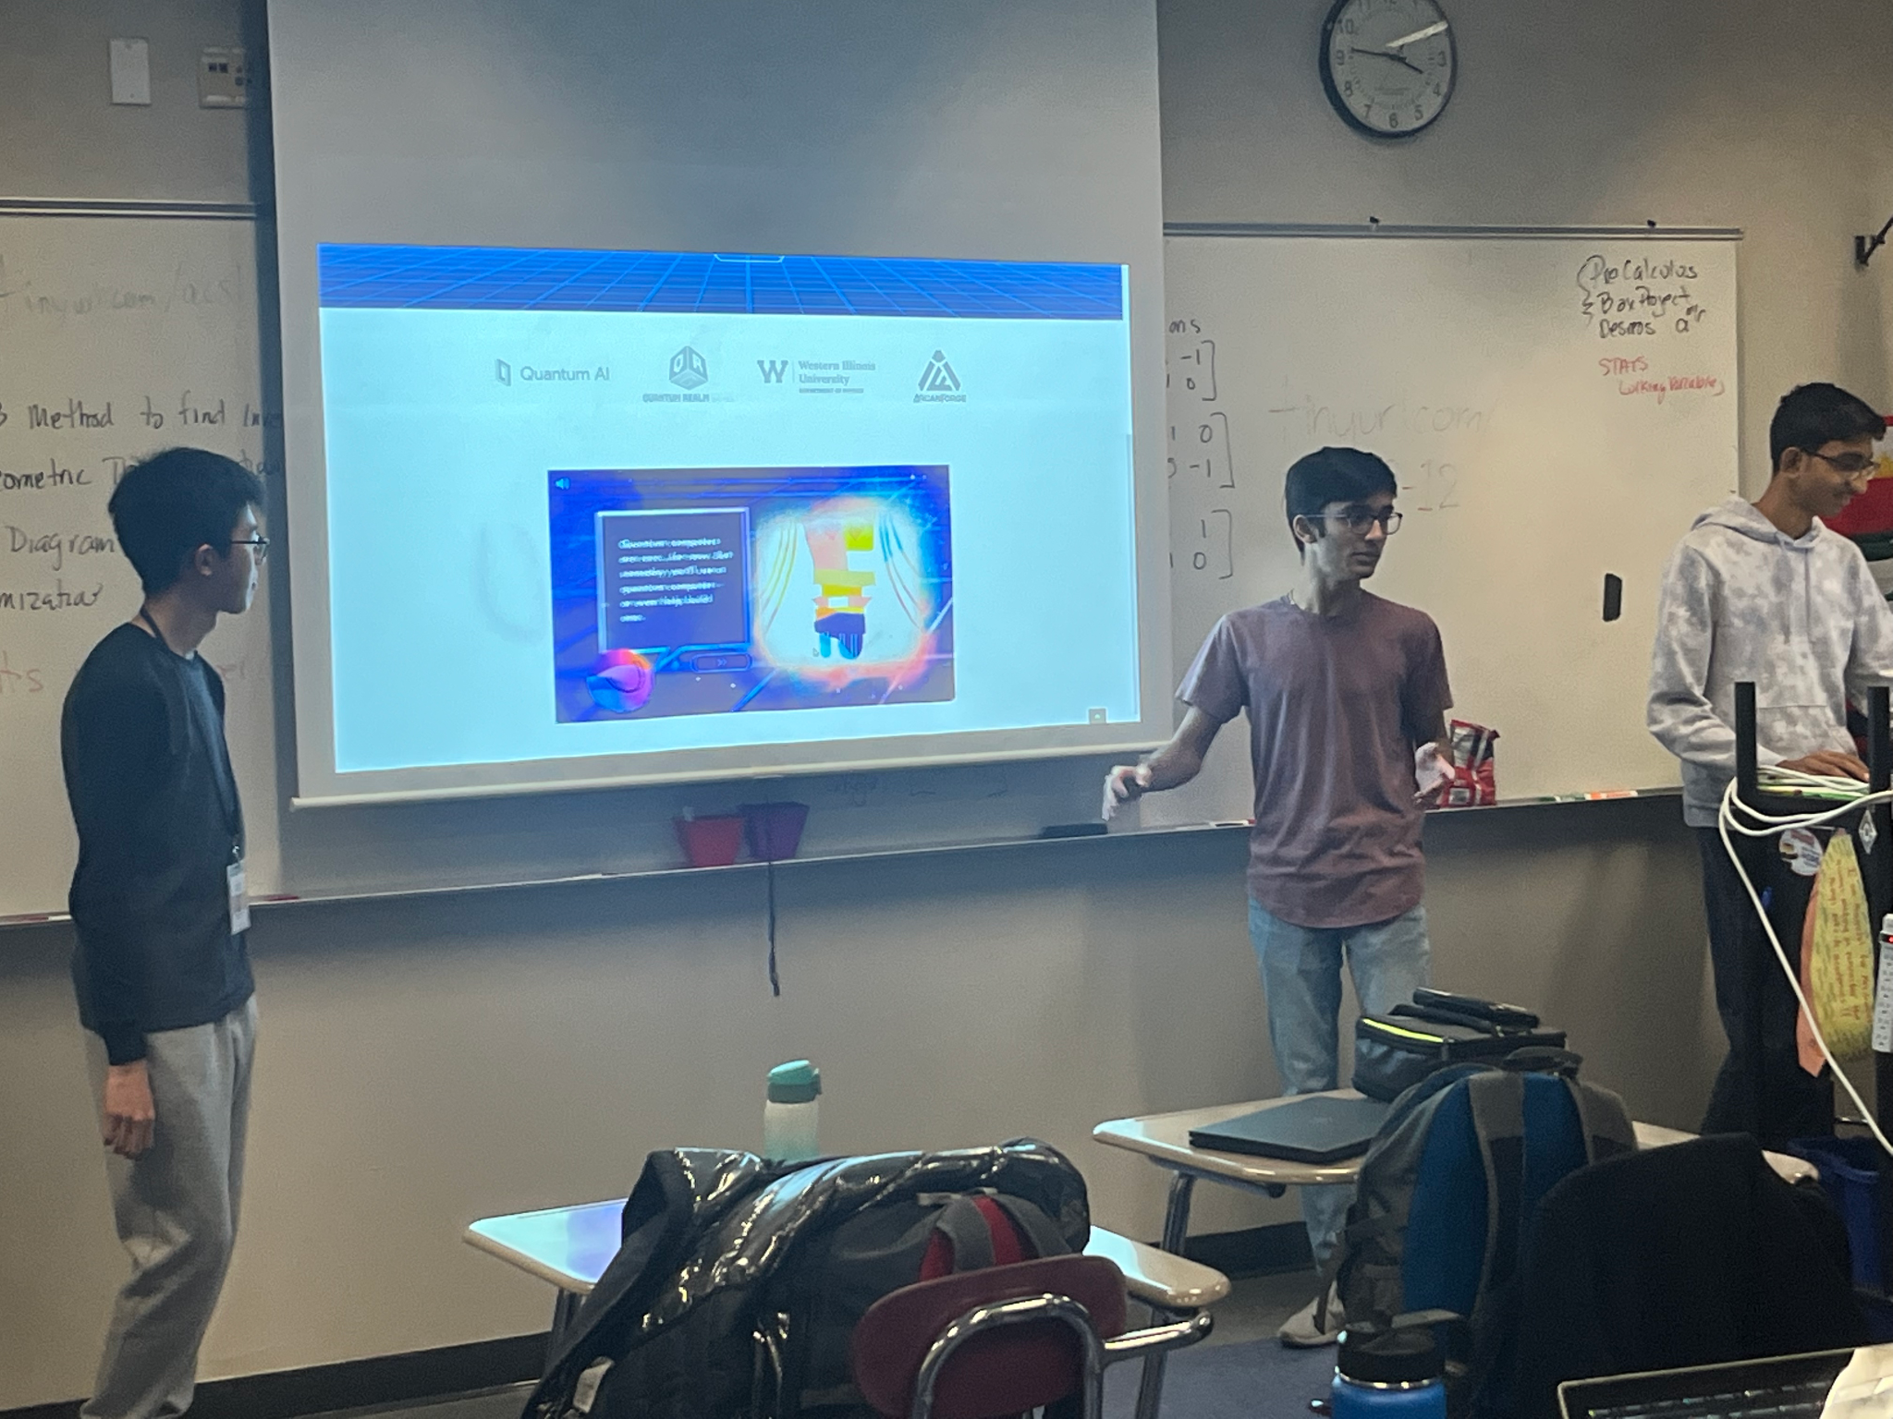
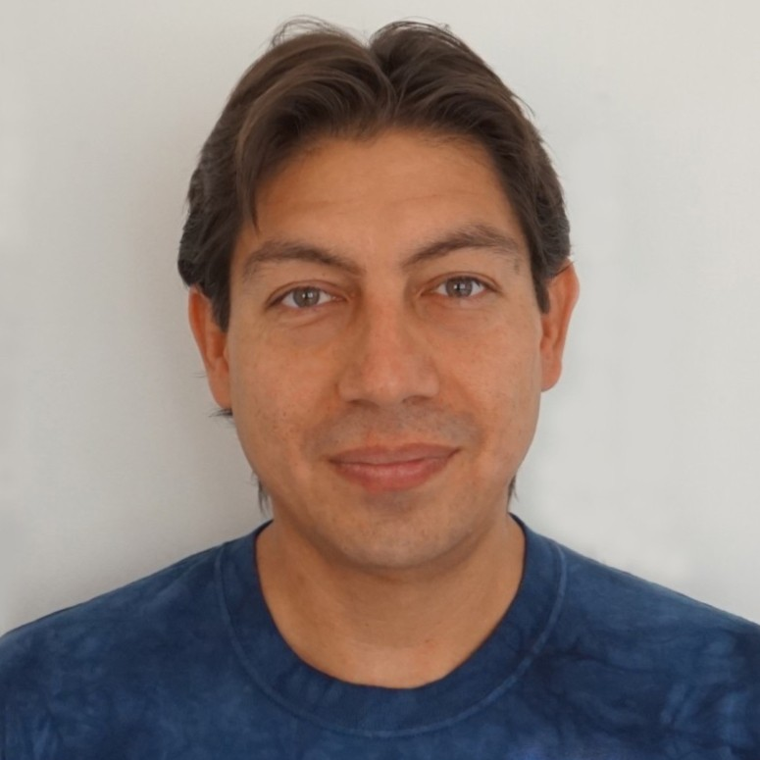
Community Engagement
Bring awareness of progress to community
Shared Quantum Chess activity with feedback
Teach impact/importance of quantum computing
Participated in a district wide presentation to discuss space exploration
Encourage pursuit of career in aerospace
Collaborated with Mr. Christian North from MIT
Feedback and tips for Lunar Explorer
Share success stories and advice for students
Maintain & update Instagram/Twitter accounts
CHRISTIAN NORTH
MIT Lincoln Laboratories
Pranav Sitaraman, Yuvraj Lakhotia, Benjamin Louie, Sushant Chadha, Akshada Guruvayur

Slide 12
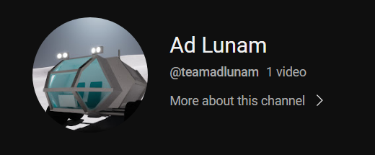
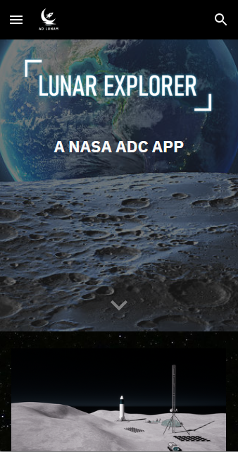
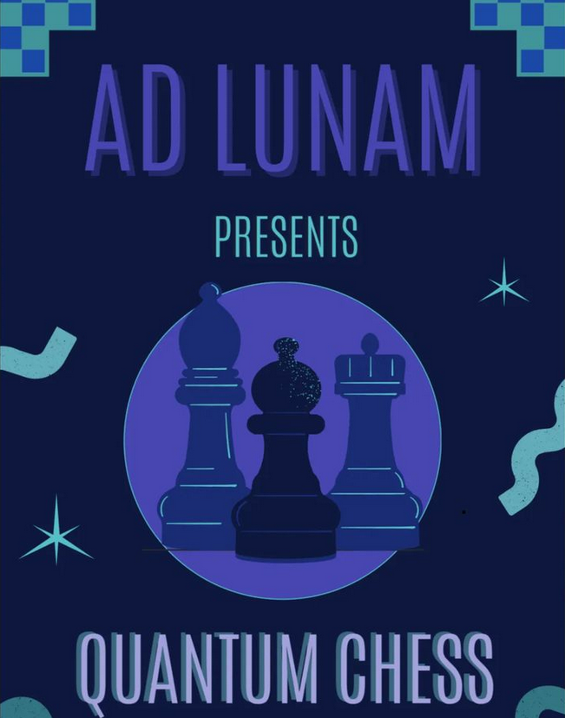
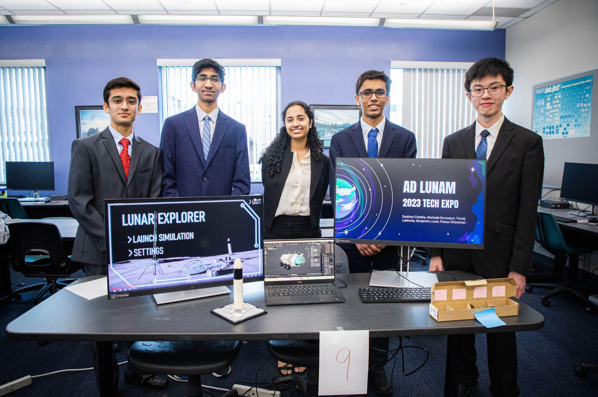
Community Engagement
Pranav Sitaraman, Yuvraj Lakhotia, Benjamin Louie, Sushant Chadha, Akshada Guruvayur

Slide 13
App Demonstration
Pranav Sitaraman, Yuvraj Lakhotia, Benjamin Louie, Sushant Chadha, Akshada Guruvayur

Slide 14
SCaN Technical Suggestions
Add labels to units and reduce numerical precision to improve accuracy
Check azimuth and elevation angle calculations
Incorporate a color key for color textures
Show colored path to the destination for wayfinding
Increase communication checkpoint visibility
Include the Earth in the background at its location with respect to the Moon
Learned more about Lunar Fixed Frame & how to properly use it
Greatly improved app aesthetic, accuracy, and accessibility!
Pranav Sitaraman, Yuvraj Lakhotia, Benjamin Louie, Sushant Chadha, Akshada Guruvayur

Slide 15
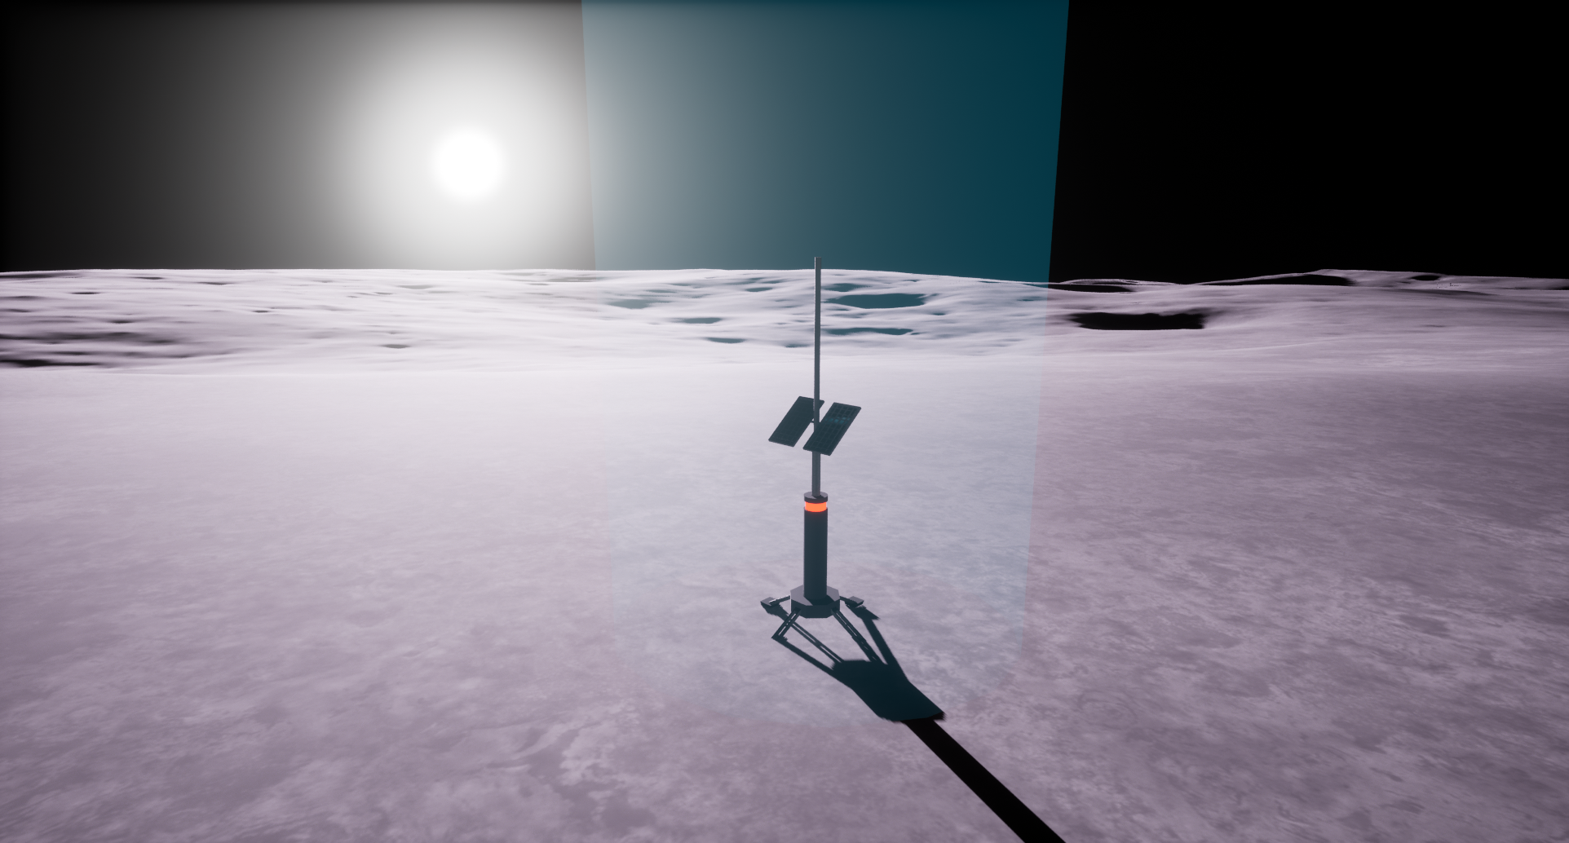
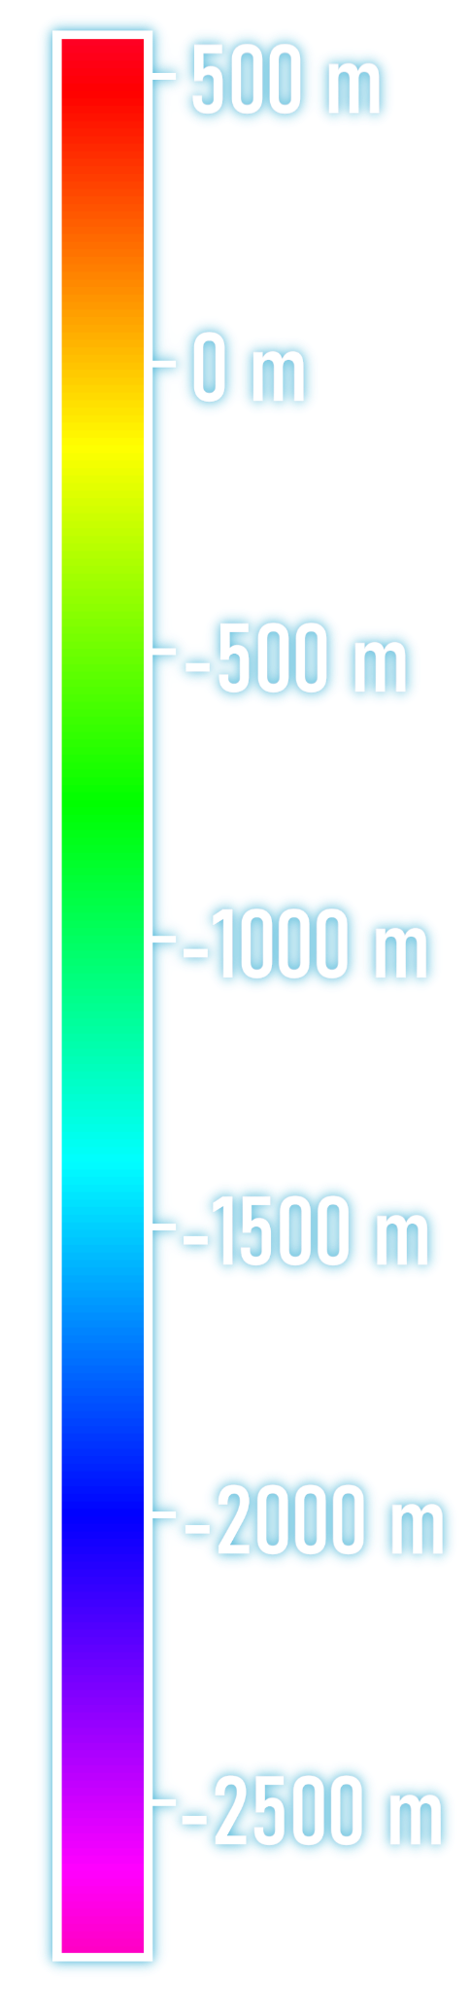
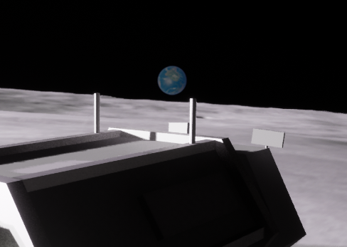
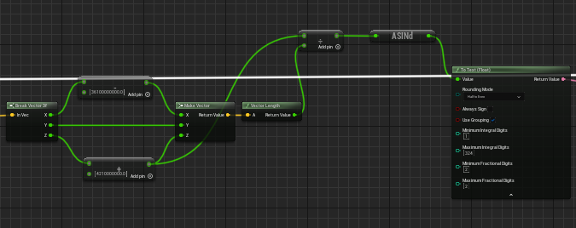
New Developments
Added Features:
Added holographic columns to checkpoints
Added Earth in the background
Added color scales to HUD
Bug Fixes:
Fixed Azimuth angles
Fixed Elevation angles
Pranav Sitaraman, Yuvraj Lakhotia, Benjamin Louie, Sushant Chadha, Akshada Guruvayur

Slide 16
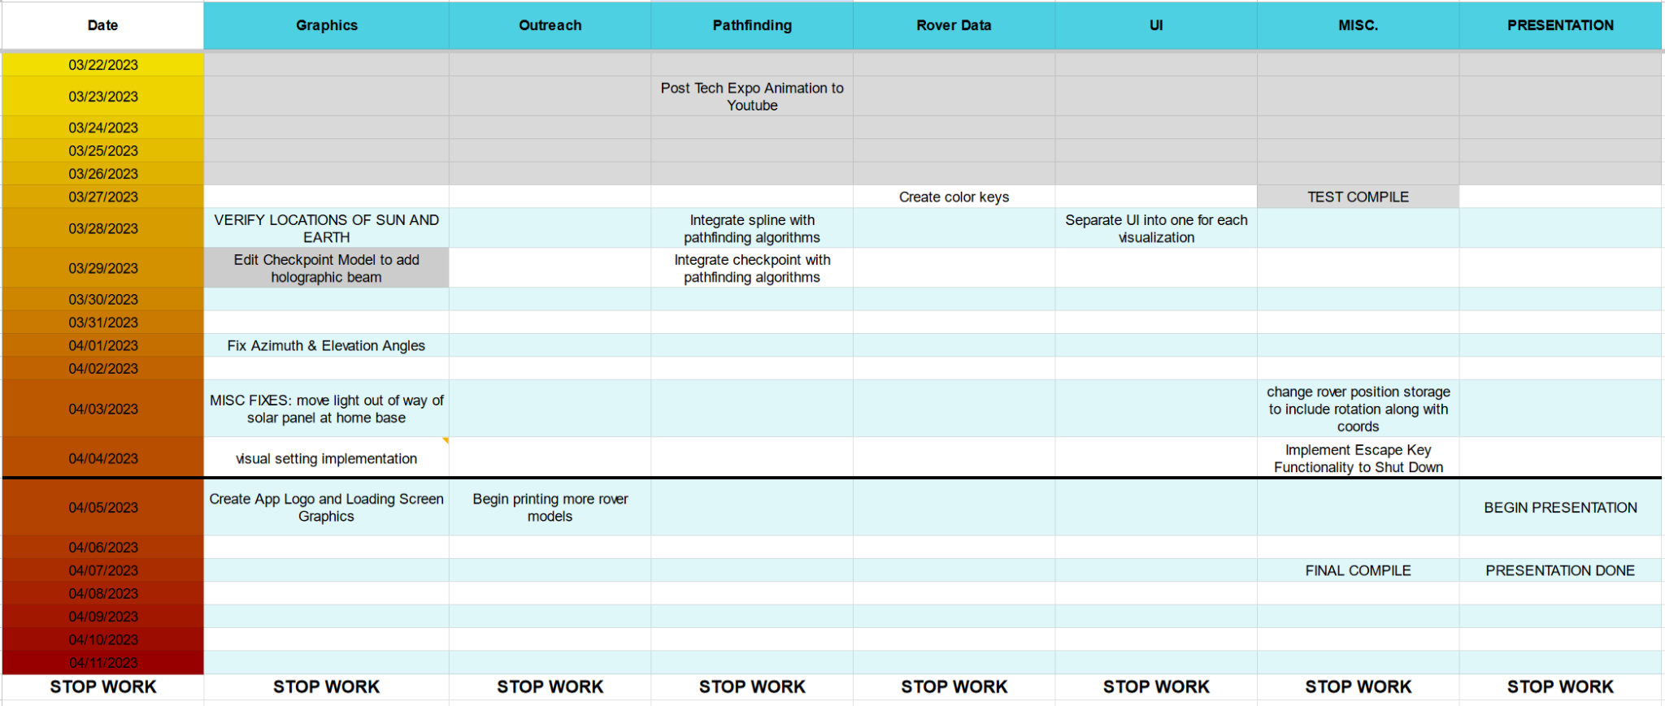
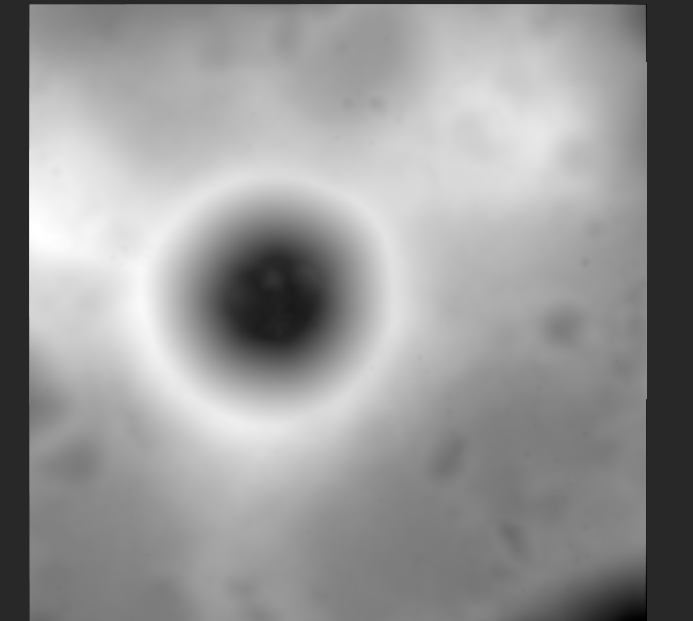
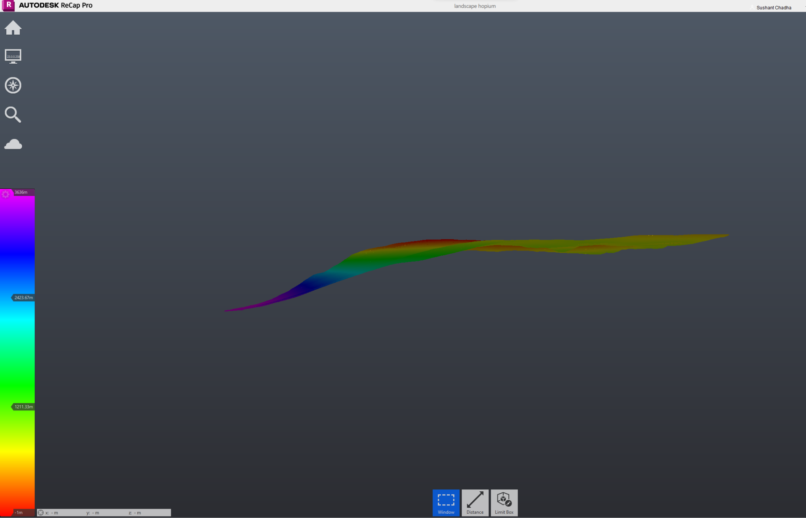
Lessons Learned
Scheduling: time is key
Helps to keep track of objectives
Reduces tendencies to procrastinate
C++ Integration with Blueprint
Pathfinding Integration & UI Communication
Image & Point Cloud Manipulation
Generating terrain & terrain layers
Pranav Sitaraman, Yuvraj Lakhotia, Benjamin Louie, Sushant Chadha, Akshada Guruvayur

Slide 17
Future Use
Best Practices:
Create a Schedule
Helps keep development on track
Leaves wiggle room in case issues arise
Have clear communication
Everyone should know what’s going on
Next Steps:
Real-time Sun/Earth positions
Additional Slope Restrictions
Additional app hosting options
Include additional candidate landing sites
Pranav Sitaraman, Yuvraj Lakhotia, Benjamin Louie, Sushant Chadha, Akshada Guruvayur

Slide 18
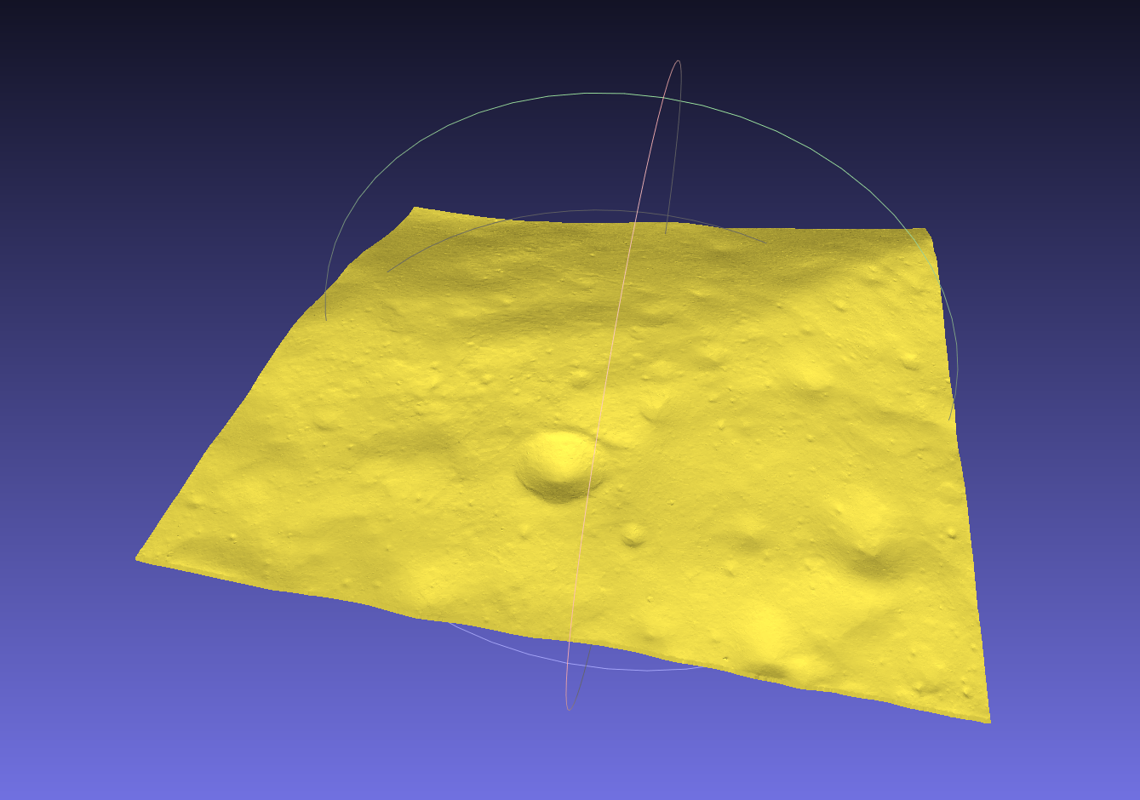
Our Experience
Did not have time to work on this app during school hours
Had to adjust time required to unlock certain milestones
Work regularly done at late hours
Gained many new skills
All new to the coding aspect of Unreal Engine
Little experience in image manipulation
Handling large data sets & creating point clouds
Pathfinding Integration
Pranav Sitaraman, Yuvraj Lakhotia, Benjamin Louie, Sushant Chadha, Akshada Guruvayur

Slide 19
Acknowledgements
Programs
Unreal Engine 5
Blender
GIMP
Paint 3D
Meshlab
Matplotlib
Seaborn
Font
Bahnschrift
Misc.
Earth surface texture from www.shadedrelief.com
Our work wouldn’t have been possible without:
Michelle Gomes (CS Club advisor)
Our parents
Samuel Lihn & Aarav Agarwal (mentors in EECS)
Chris North (MIT Lincoln Laboratories Instructor)
And thank you to NASA for this amazing opportunity and to the SCaN team for their suggestions throughout the app development process!
Pranav Sitaraman, Yuvraj Lakhotia, Benjamin Louie, Sushant Chadha, Akshada Guruvayur

Slide 20
THANKS!
Any Questions?
Pranav Sitaraman, Yuvraj Lakhotia, Benjamin Louie, Sushant Chadha, Akshada Guruvayur

